Slide 1

Exciting the spin transitions of ${}_{}^{167}{Er:CaWO_{4}}$with Propagating Microwaves via Superconducting Electrical Circuits
Hayden Nathanael Tanis
Technische Universität München
Walther-Meissner Institute

Slide 2
Introduction

Slide 3
Chapter 2: Rare-Earth Physics and Spin Dynamics

Slide 4
Rare Earth Elements

Slide 5
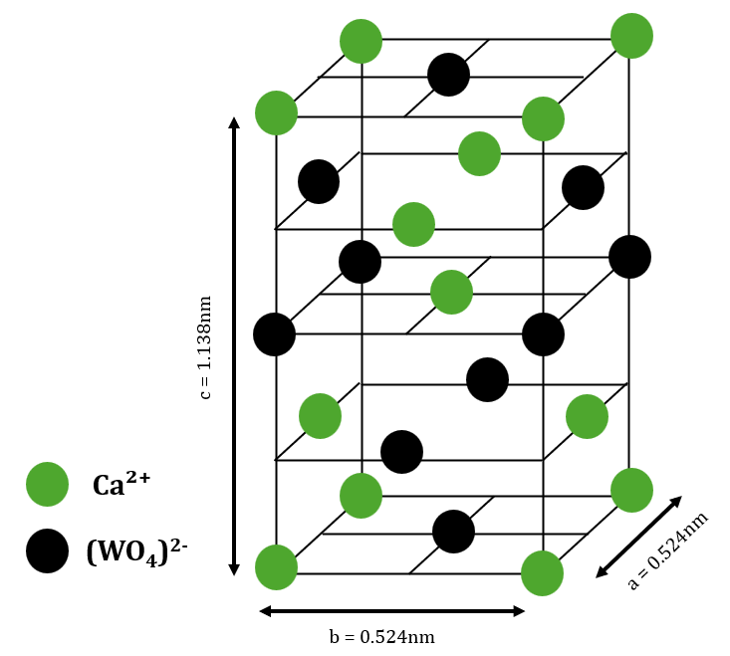
Host Material
Figure: Unit Crystal of Calcium Tungstate

Slide 6
Erbium Dopants in Calcium Tungstate
Total Hamiltonian consists of the free-ion energy, crystal field term, and the spin-Hamiltonian.

Slide 7
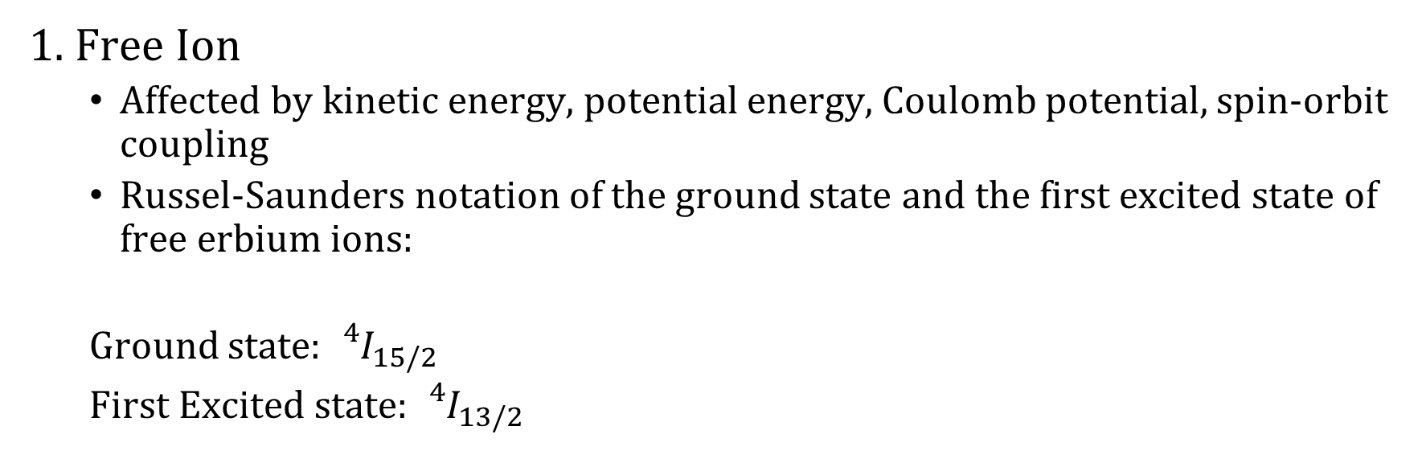
Erbium Dopants in Calcium Tungstate
1. Free Ion
Affected by kinetic energy, potential energy, Coulomb potential, spin-orbit coupling
Russel-Saunders notation of the ground state and the first excited state of free erbium ions:
Ground state: ${{}_{}^{4}I}_{15/2}$
First Excited state: ${{}_{}^{4}I}_{13/2}$

Slide 8
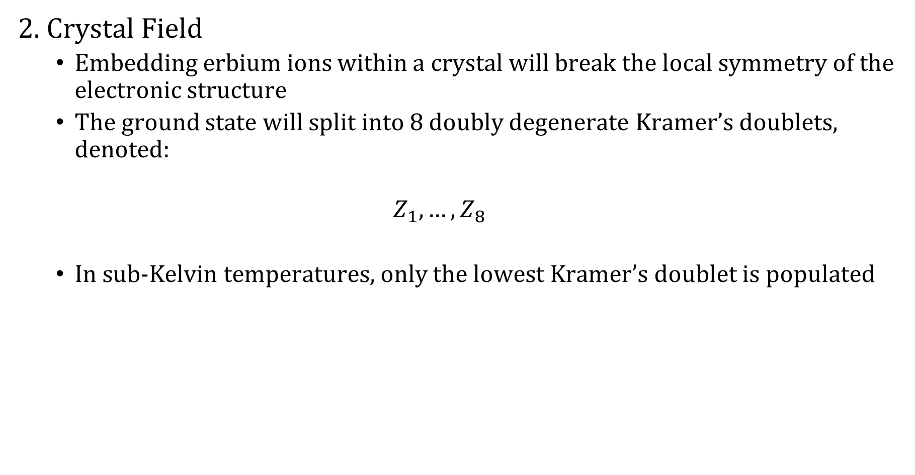
Erbium Dopants in Calcium Tungstate
2. Crystal Field
Embedding erbium ions within a crystal will break the local symmetry of the electronic structure
The ground state will split into 8 doubly degenerate Kramer’s doublets, denoted:
$$Z_{1},…,Z_{8}$$
In sub-Kelvin temperatures, only the lowest Kramer’s doublet is populated

Slide 9
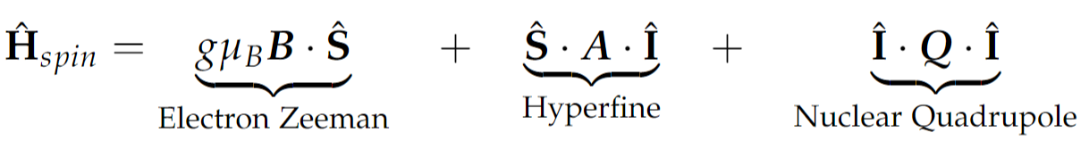
Erbium Dopants in Calcium Tungstate
3. Spin Hamiltonian
The effective spin-Hamiltonian of Erbium consists of the following terms:
Electron-Zeeman Interaction
Hyperfine Interaction
Nuclear Quadrupole Interaction

Slide 10
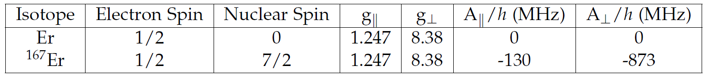
Erbium Dopants in Calcium Tungstate
Known spin-Hamiltonian parameters of Erbium isotopes

Slide 11
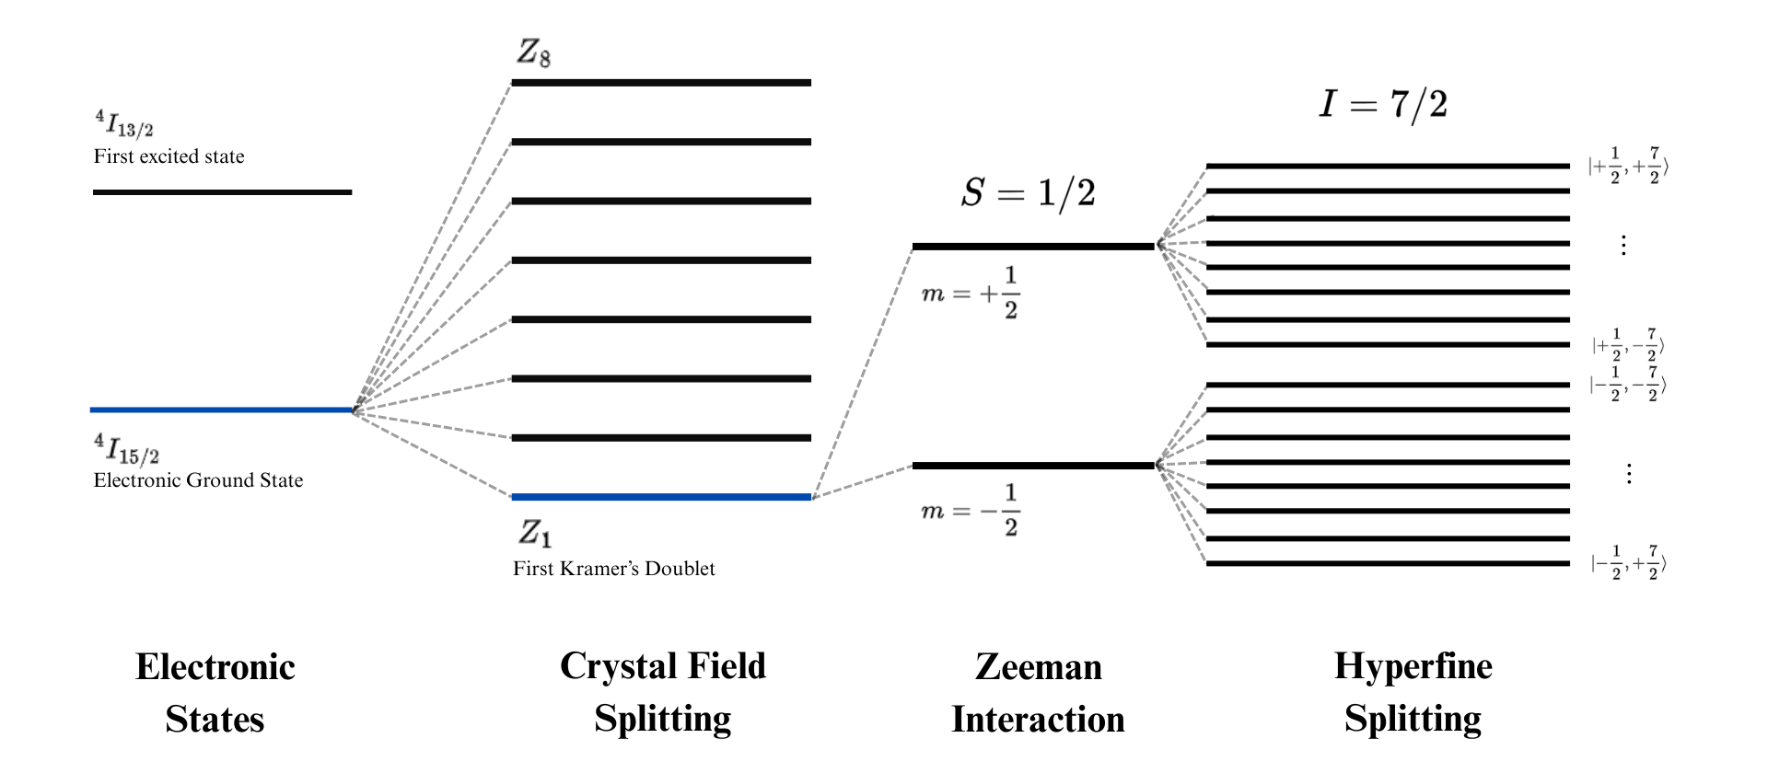
Erbium Dopants in Calcium Tungstate
Energy Structure of Erbium

Slide 12
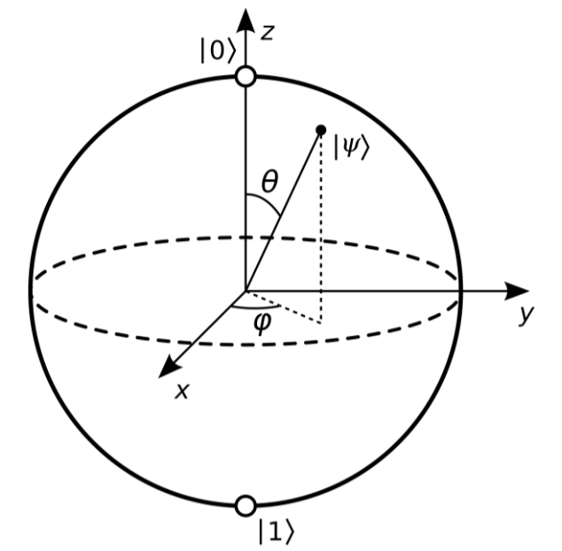
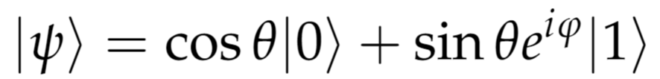
Spin Dynamics
Two-level quantum systems
The quantum state of any arbitrary two-level quantum system can be represented as a superposition of the ground state and the excited state.
Standard representation of a two-level quantum system via Bloch Sphere
A Kramer’s doublet can be treated as an effective spin S = ½ system which is a two-level quantum system

Slide 13
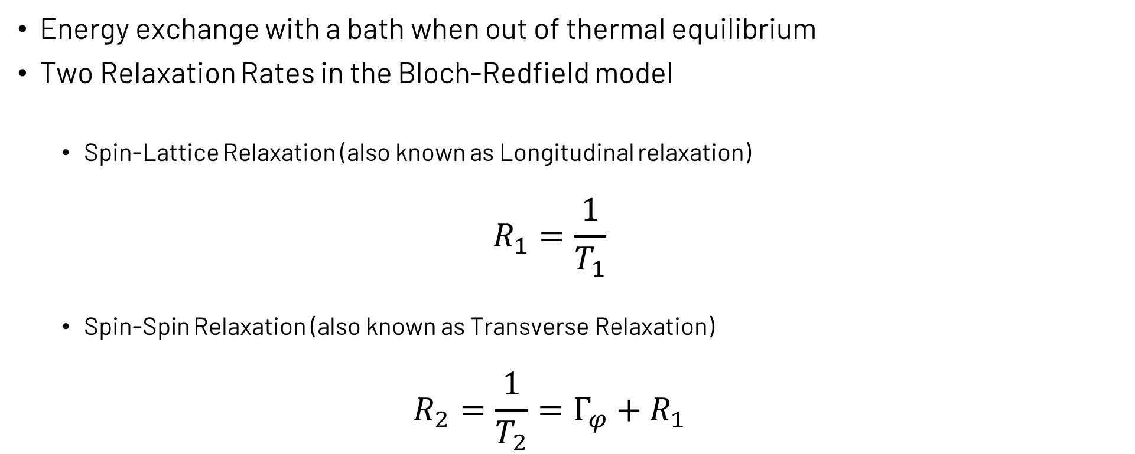
Spin Relaxation Mechanisms
Relaxation Processes
Energy exchange with a bath when out of thermal equilibrium
Two Relaxation Rates in the Bloch-Redfield model
Spin-Lattice Relaxation (also known as Longitudinal relaxation)
$$R_{1}=\frac{1}{T_{1}}$$
Spin-Spin Relaxation (also known as Transverse Relaxation)
$$R_{2}=\frac{1}{T_{2}}=Γ_{φ}+R_{1}$$

Slide 14
Spin Relaxation Mechanisms
Spin-Lattice Relaxation (SLR)
Rate with which an electron spin returns to thermal equilibrium
Interaction between spins and crystal lattice will induce energy loss
In the Bloch Sphere: The longitudinal component of the state vector will return to its ground state after a period of time (T1 time)
In complex systems with multiple energy levels - decay to thermal equilibrium will follow a multi-exponential decay function

Slide 15
Spin Relaxation Mechanisms
Processes behind Spin-Lattice Relaxation (SLR)
Main processes
Process | Direct Phonon Process | Raman Process | Orbach Process
Type | Single phonon process | Higher order process (two phonon interaction)
Contribution in sub-Kelvin temperature | Direct exchange of phonons between crystal lattice and spin-system Main process governing SLR in sub-kelvin temperatures | Effect is negligible at sub-kelvin temperatures.

Slide 16
Spin Relaxation Mechanisms
Spin flip-flop interactions
Caused by the interaction between the magnetic dipoles of two spins – induces cross relaxation if the two spins are spatially close to each other
Flip-flop interaction dominates the relaxation rate at low magnetic fields
At higher fields, the direct phonon process will overpower the flip-flop interaction

Slide 17
Chapter 3 Experimental Methodology

Slide 18
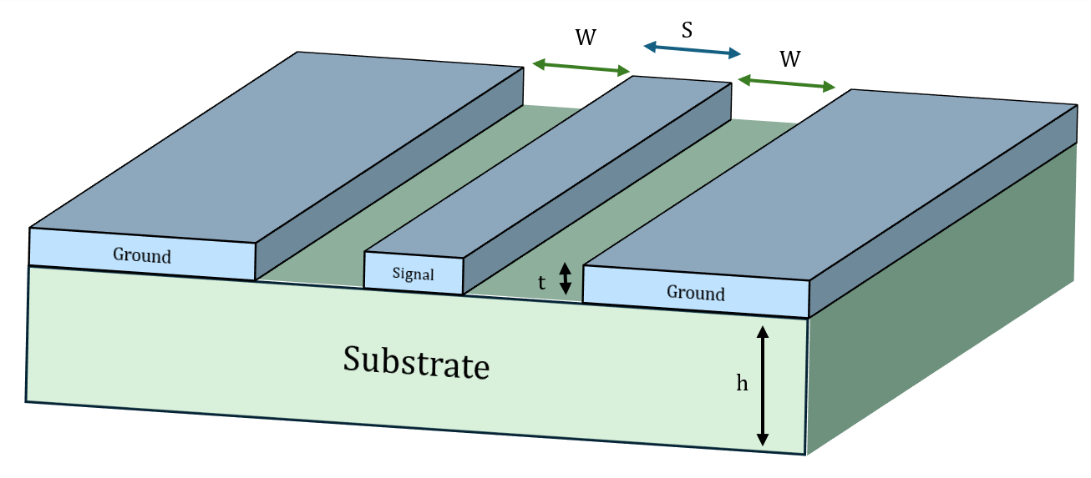
BEPR with Superconducting Coplanar Waveguides

Slide 19
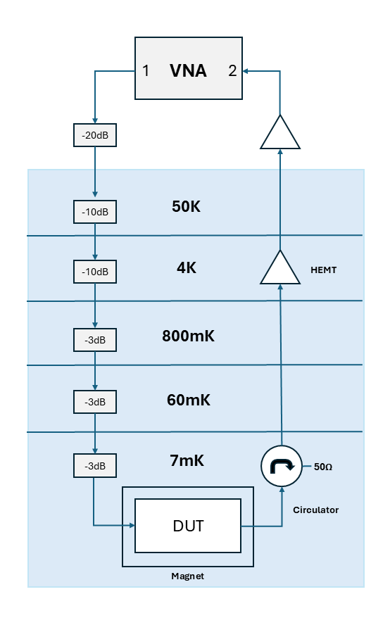
Measurement Setup

Slide 20
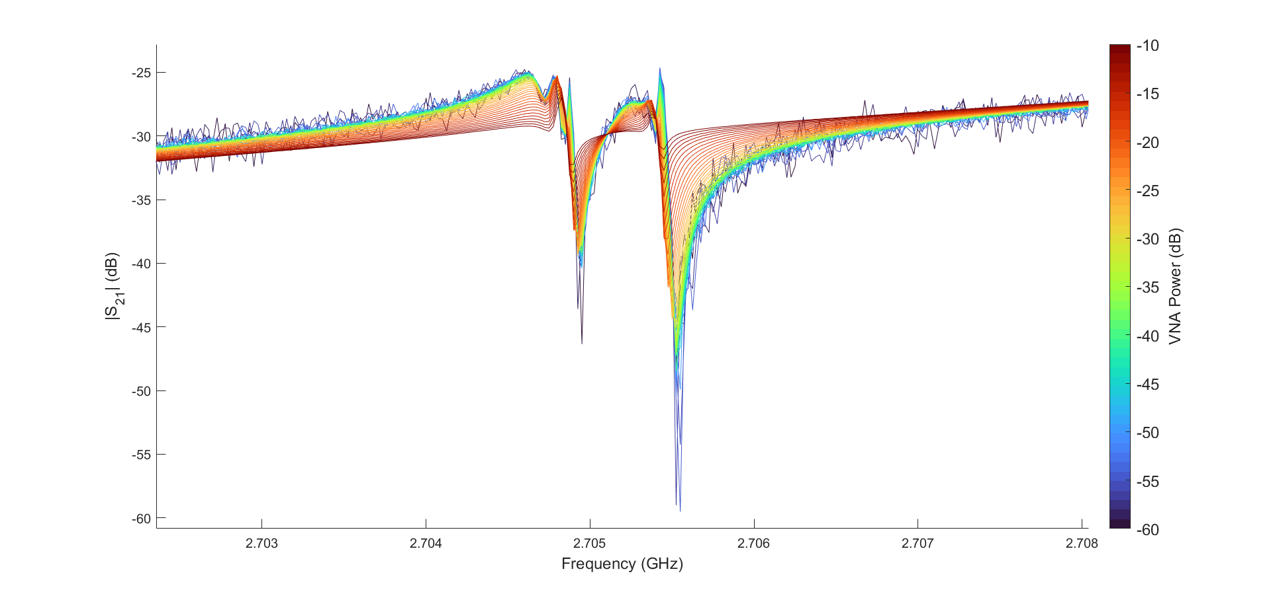
Power Sweep
Higher VNA power, shallower absorption dip
Maximum VNA power for probing: -42 dB

Slide 21
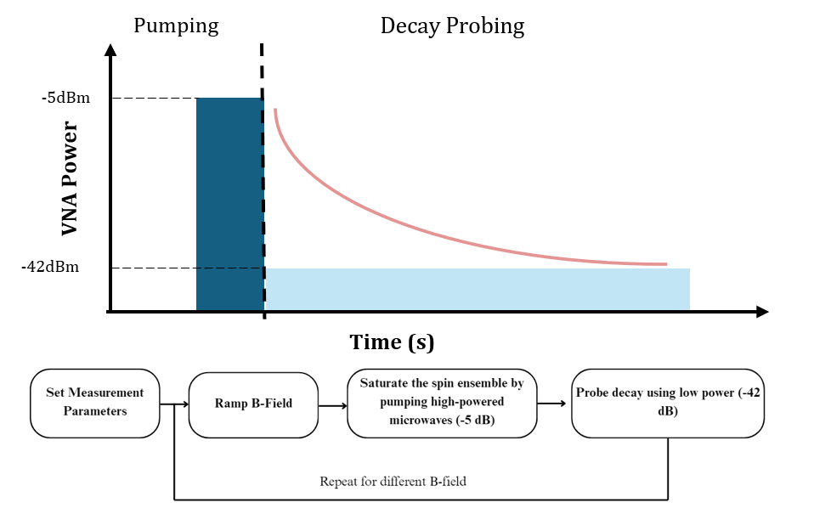
Saturation Recovery Measurements

Slide 22
Chapter 4 Results and Discussion

Slide 23
Zero-Field Spectroscopy
Spectroscopy measurements done in zero-magnetic field
Identifies hyperfine transitions
Energy level splitting determined by field independent terms
Zeeman interaction does not play a role
Following measurements
Broadband ZF-Spectroscopy of the sample
Narrowband Spectroscopy show detected spin transitions
Notes:
Firstly I would like to present the results of spectroscopy measurements done under zero magnetic field conditions.

Slide 24
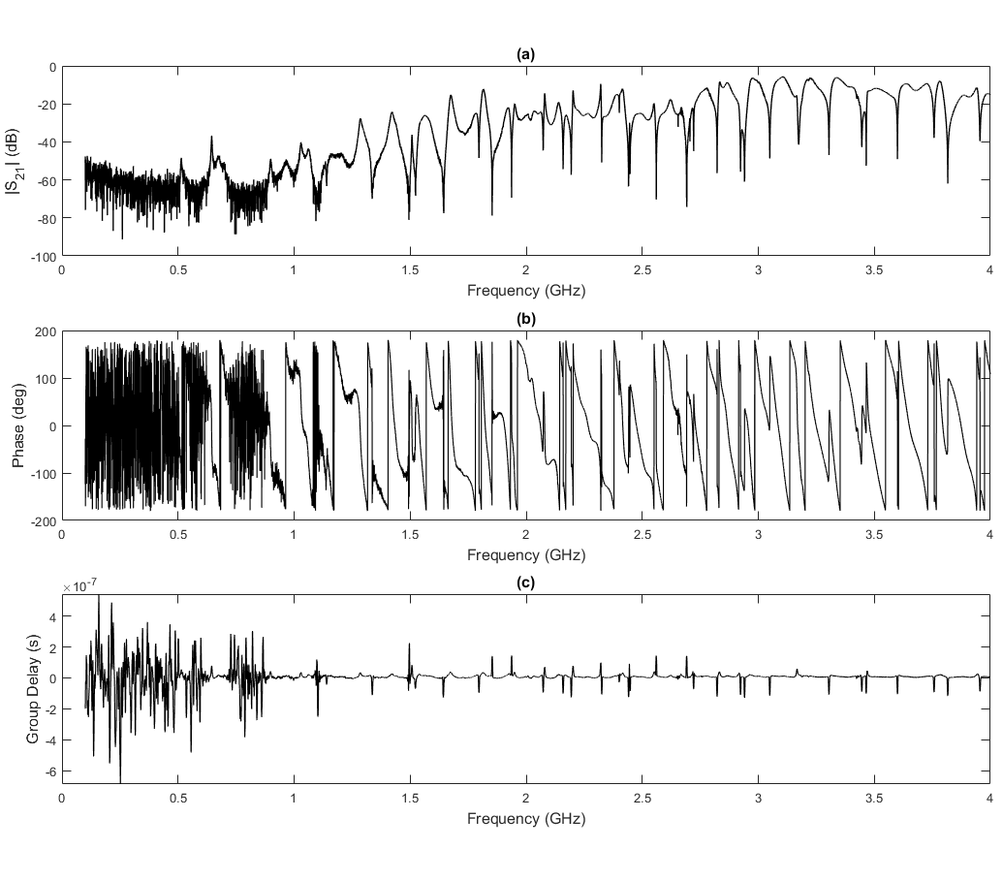
Zero-Field Spectroscopy
Broadband Spectroscopy
Notes:
Firstly I would like to present the results of spectroscopy measurements done under zero magnetic field conditions.

Slide 25
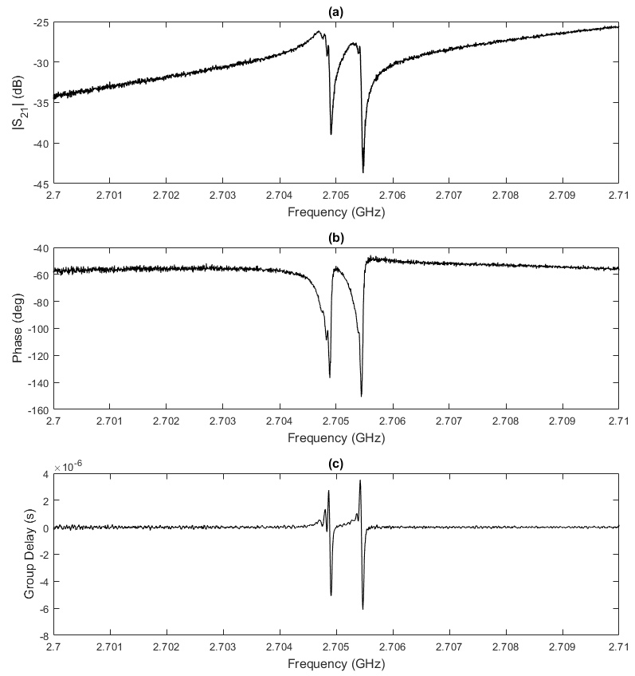
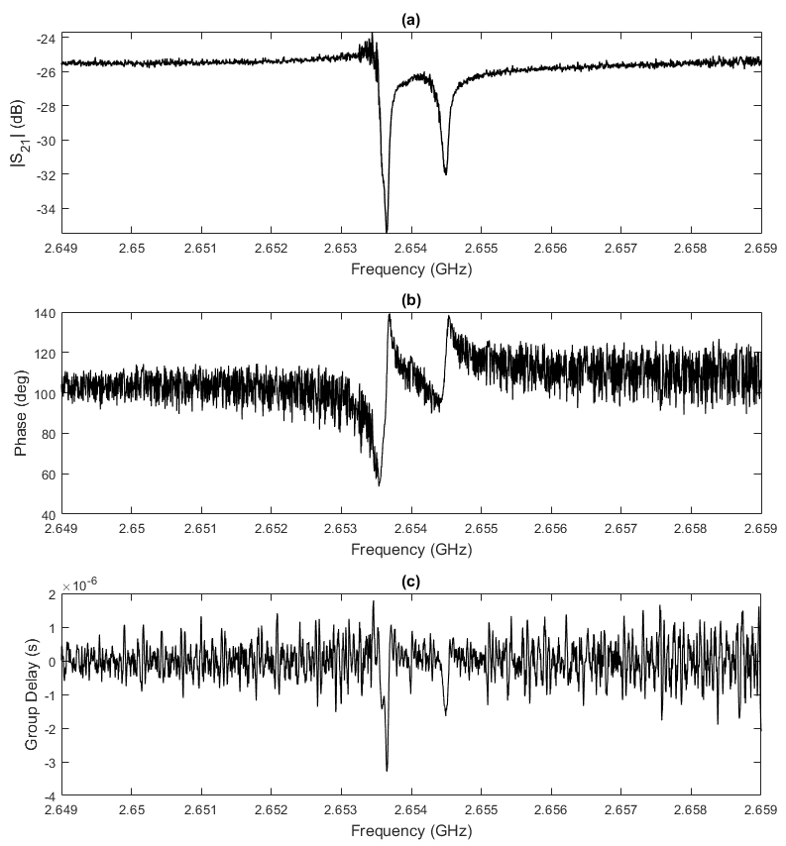
Zero-Field Spectroscopy
2.7 GHz transition
2.6 GHz transition
Hyperfine Transitions

Slide 26
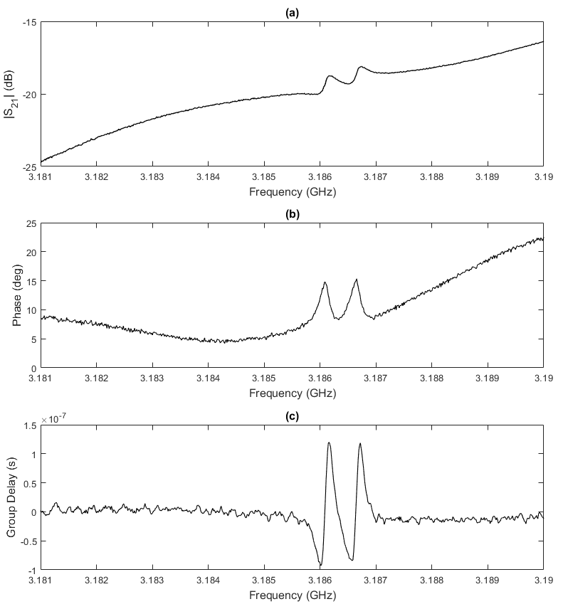
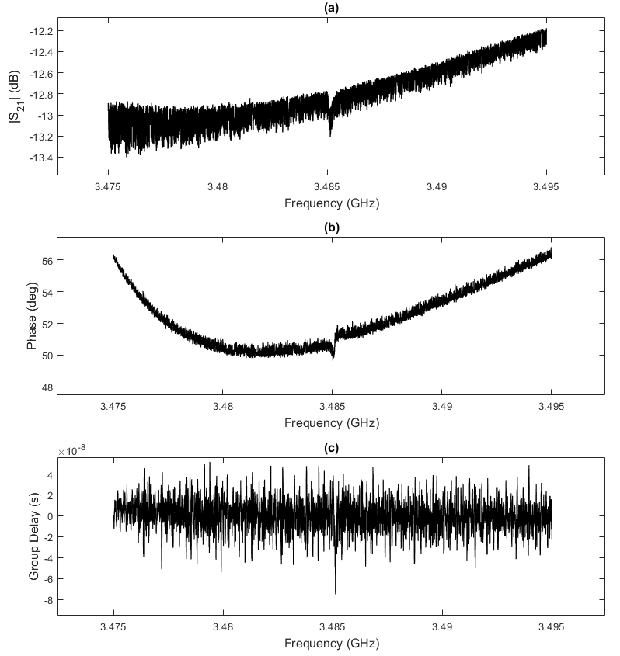
Zero-Field Spectroscopy
3.2 GHz transition
3.4 GHz transition
Hyperfine Transitions

Slide 27
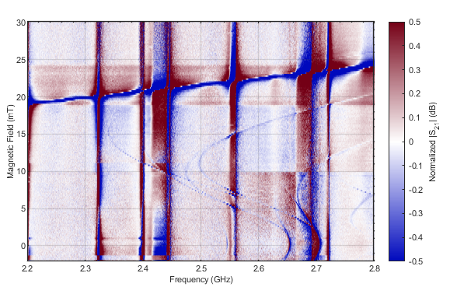
Magnetic Field Sweeps

Slide 28
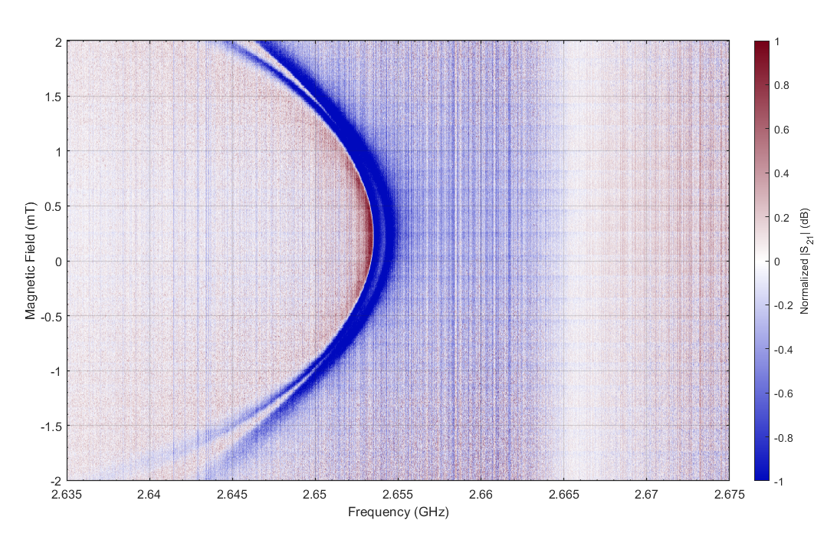
Magnetic Field Sweeps
Offset ca. 0.2mT

Slide 29
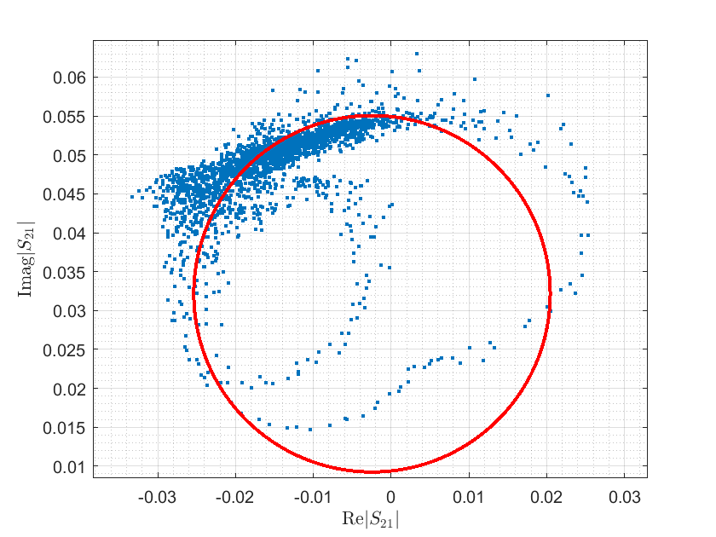
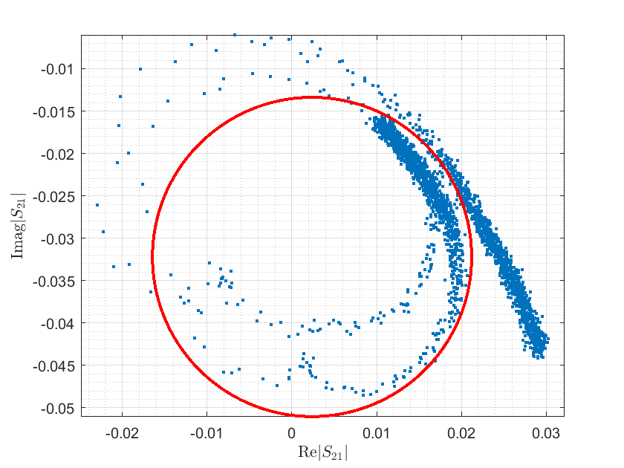
Circle Correction Procedure
Original datasets in complex plane

Slide 30
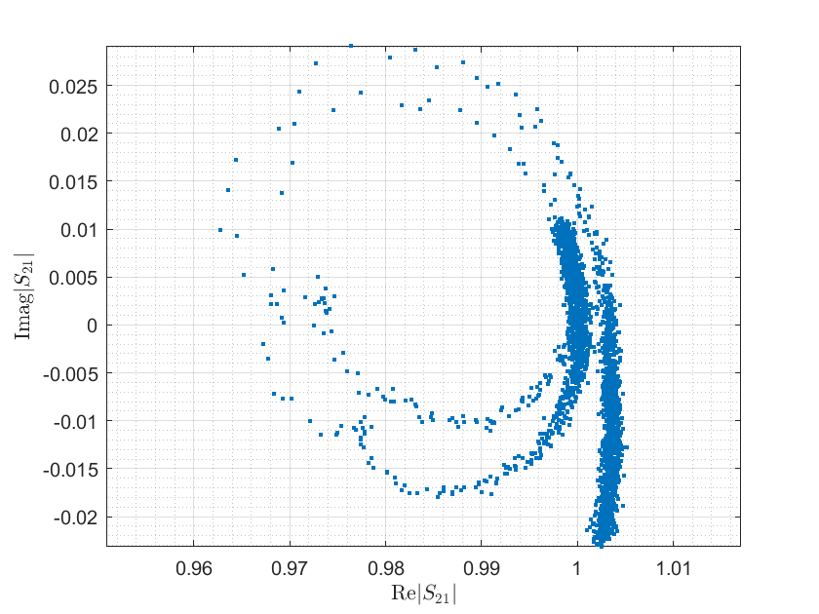
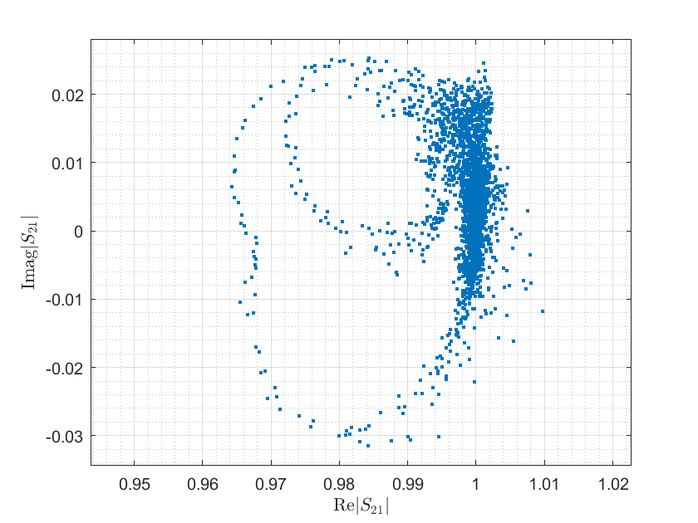
Circle Correction Procedure
Corrected datasets

Slide 31
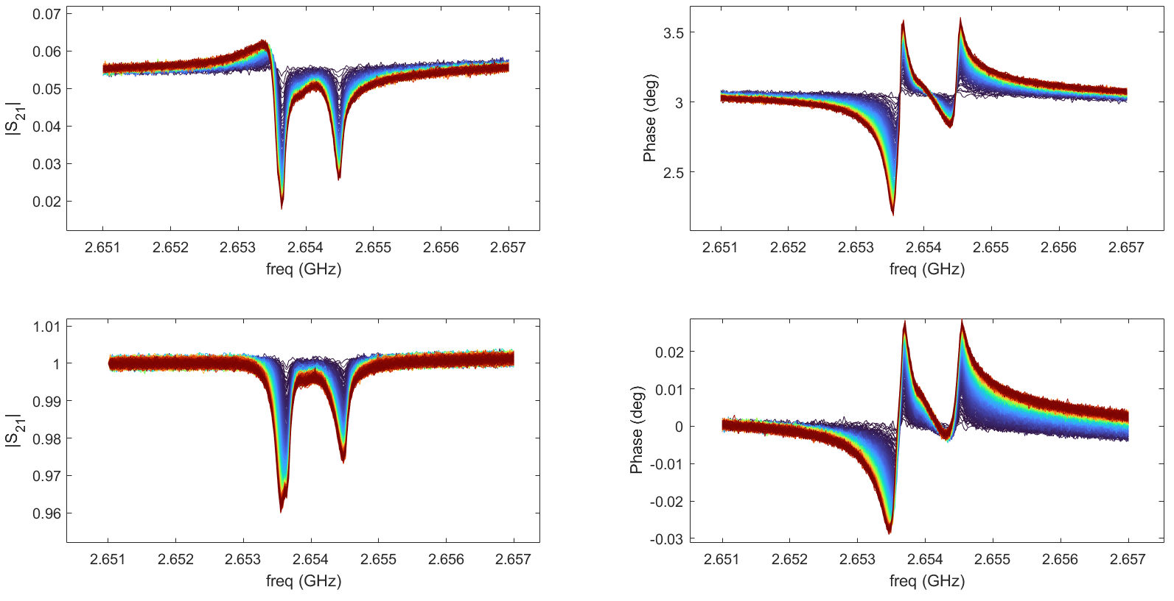
Circle Correction Procedure
Original vs Corrected Dataset in S21 vs Frequency plane

Slide 32
Field Dependent Measurements
Aim: observe how T1 relaxation time changes under the influence of low magnetic fields
Focus: Characterization of the 2.6 GHz spin transition in the presence of different magnetic fields
Magnetic Field (mT) | 0.3 | 0.55 | 0.8 | 1.05 | 1.3
VNA Center Frequency (GHz) | 2.65406 | 2.65362 | 2.6526 | 2.6513 | 2.6495

Slide 33
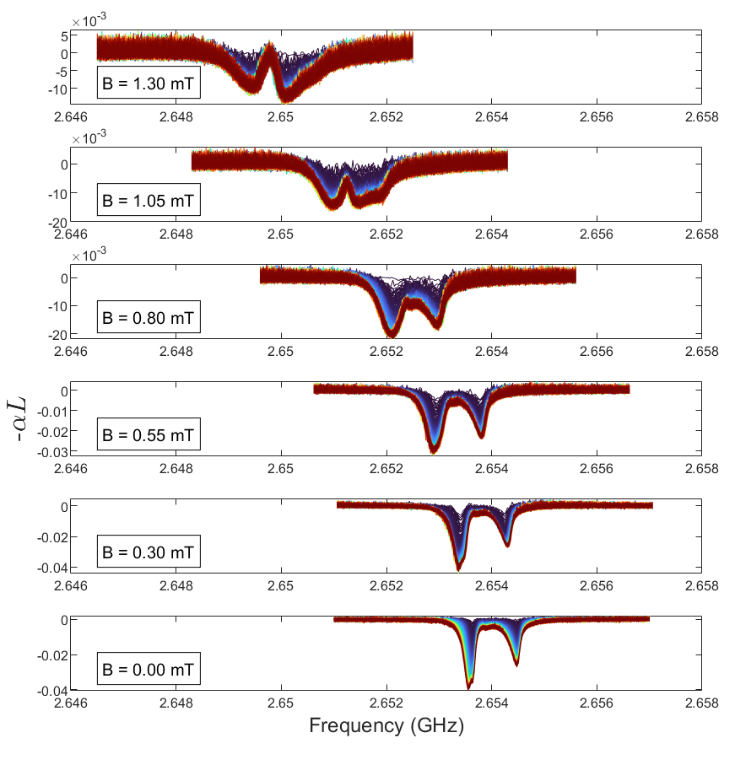
Magnetic Field Sweeps

Slide 34
Chapter 5 Conclusion

